Slide 1
Employee Expense Portal

Slide 2
Overview
Employees can report their business expenses through a web-based system called an employee expense portal, which managers can then approve or disapprove.

Slide 3
Problem Statement
A variety of businesses frequently struggle with simplified, effective employee expenditure tracking.
Paper receipts and spreadsheets are two common traditional means of tracking spending, but they can be time-consuming and error-prone. Additionally, it may be challenging for managers to swiftly and simply accept or reject expenditure claims, which causes delays and annoyance for workers.

Slide 4
Solution Overview
The solution is an employee expense portal, which simplifies and automates the filing and approval of employee expenses.
The portal's simple interface allows employees to make expense requests and monitor their progress. Managers can easily review, accept, or reject cost requests.
The Employee expenditure Portal optimises the expenditure management process, lowers errors, and increases efficiency. It also offers an admin panel for managing employees and managers.

Slide 5
Roles for Users
Admin
Employee
Manager
Create Employee and Manager.
Delete Employee and Manager.
Submit their Expenses
Track the progress of their requests.
Employee expense requests are examined, approved, or rejected.
Delete Admin.

Slide 6
Admin’s Portal
Organisational admins can only create accounts, as part of the account validation procedure, an otp is issued to the admins' organisation email addresses. If the otp is valid, the admins are confirmed and can log in to the portal.
There will be many managers and employees in the organisation, so it is important to properly assign a manager id and name while creating an account for an employee. since only managers of specific employees are able to review their expenditure requests.
The top-level manager's ID and name must be assigned when creating a manager account.

Slide 7
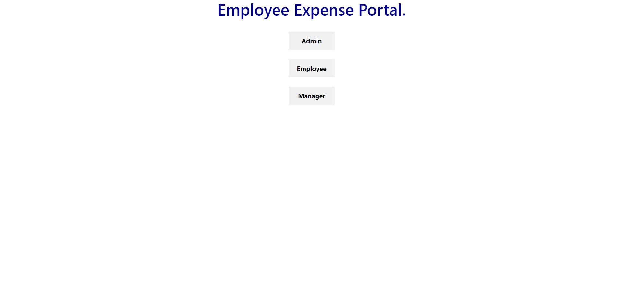
Admins Portal

Slide 8
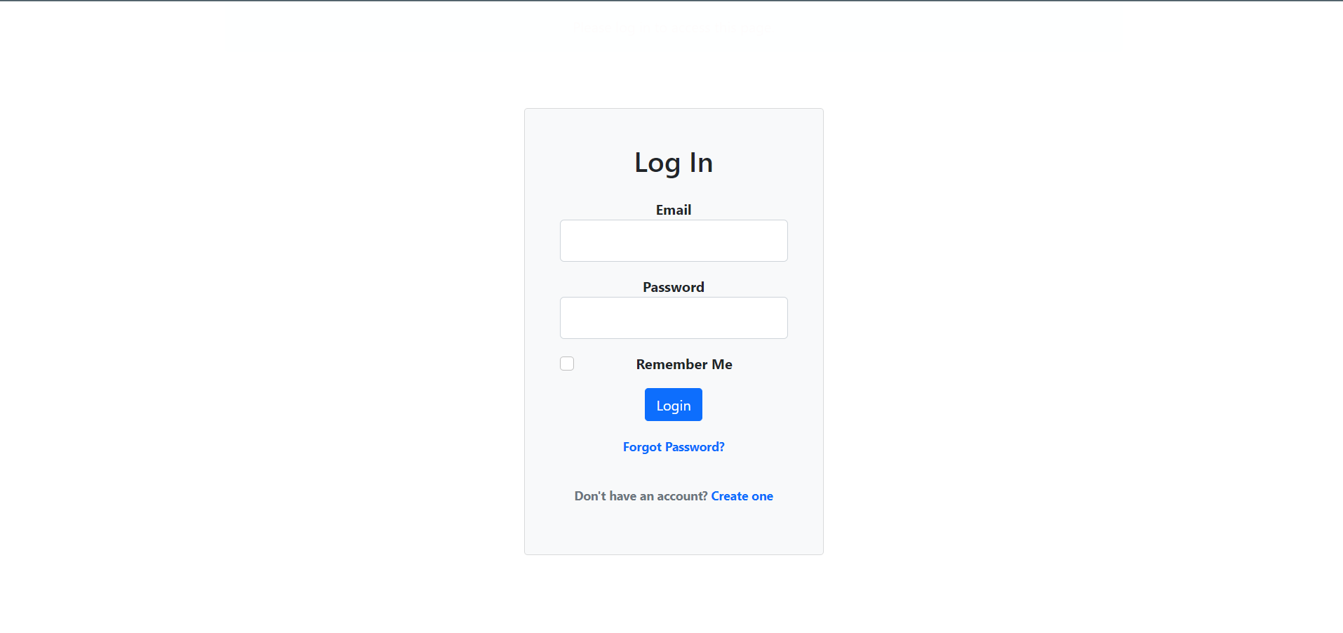
Admins Portal

Slide 9
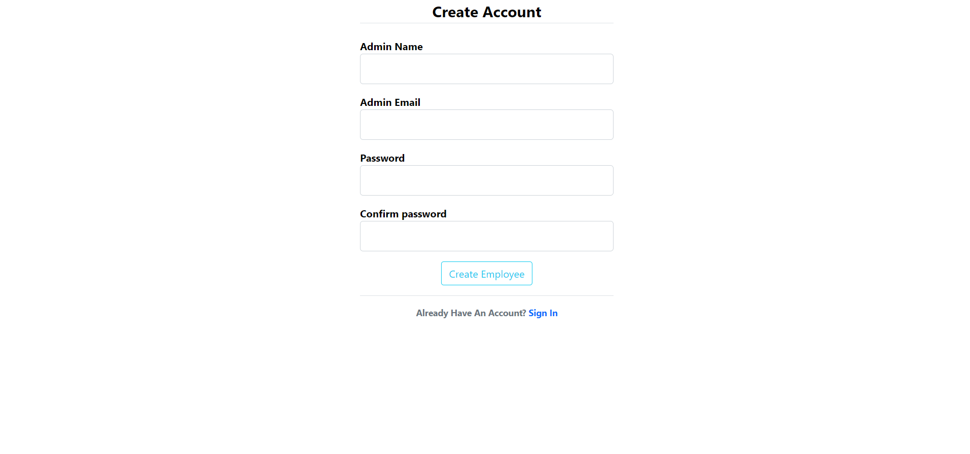
Admins Portal

Slide 10
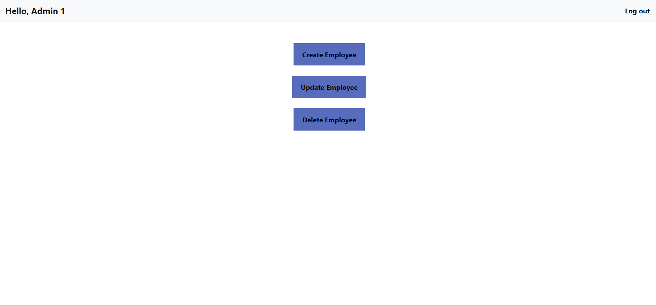
Admins Portal

Slide 11
Employee’s Portal
Employees can use the portal to upload their expenses, including the date, the cost, and an image or PDF.
When submitting their expenditure request, the date on the image or PDF must be less than 30 days; if it is more than 30 days, their request is rejected.
When an expense request is made, an email is sent to the employee and their authorised manager. They must wait a few working days before finding out the status of their expenses.
Employees must re-submit requests for reimbursement if a cost is denied, the manager will explain the reason for the denial and email the employee.

Slide 12
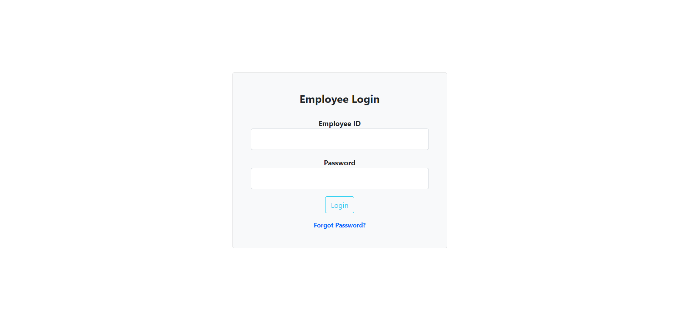
Employee’s Portal

Slide 13
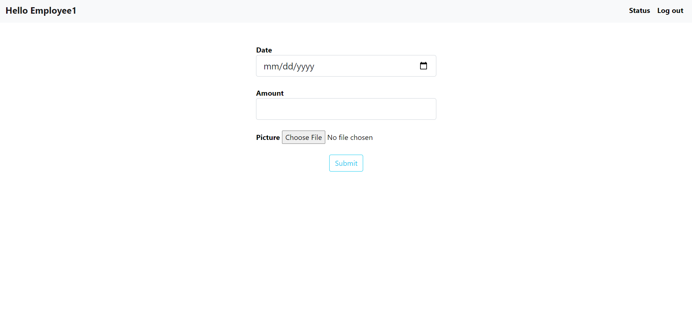
Employee’s Portal

Slide 14
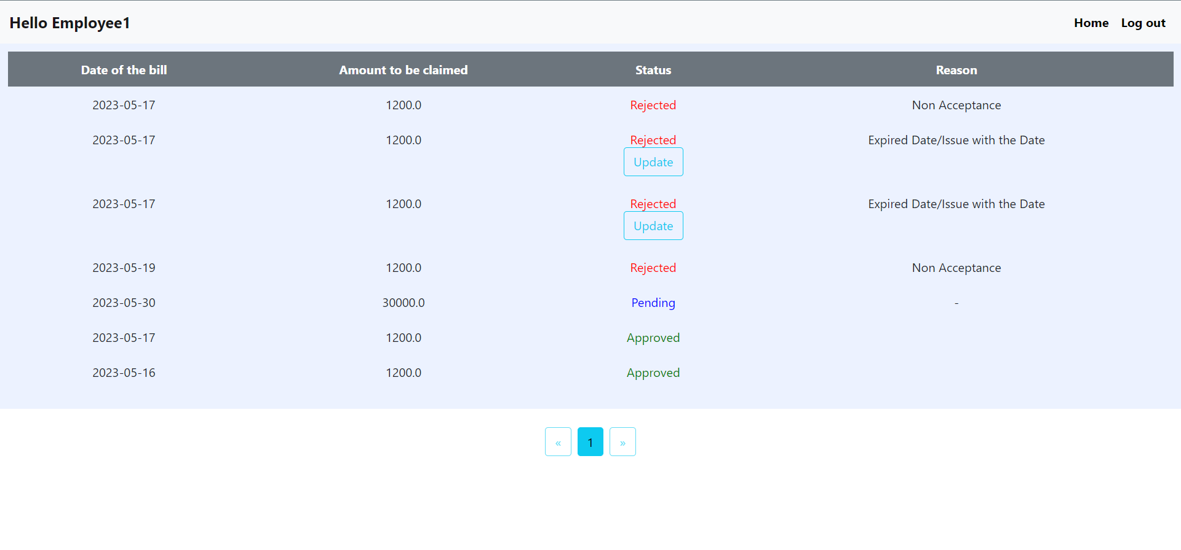
Employee’s Portal

Slide 15
Manager’s Portal
The employee's expenditure request will be displayed when the manager logs in using their employee ID.
Manager will review the employee expense request and take action, such as accepting or rejecting it. If the expense is rejected, manager has to clarify reasons.
When a manager leaves an organisation, they can delete the admin account.

Slide 16
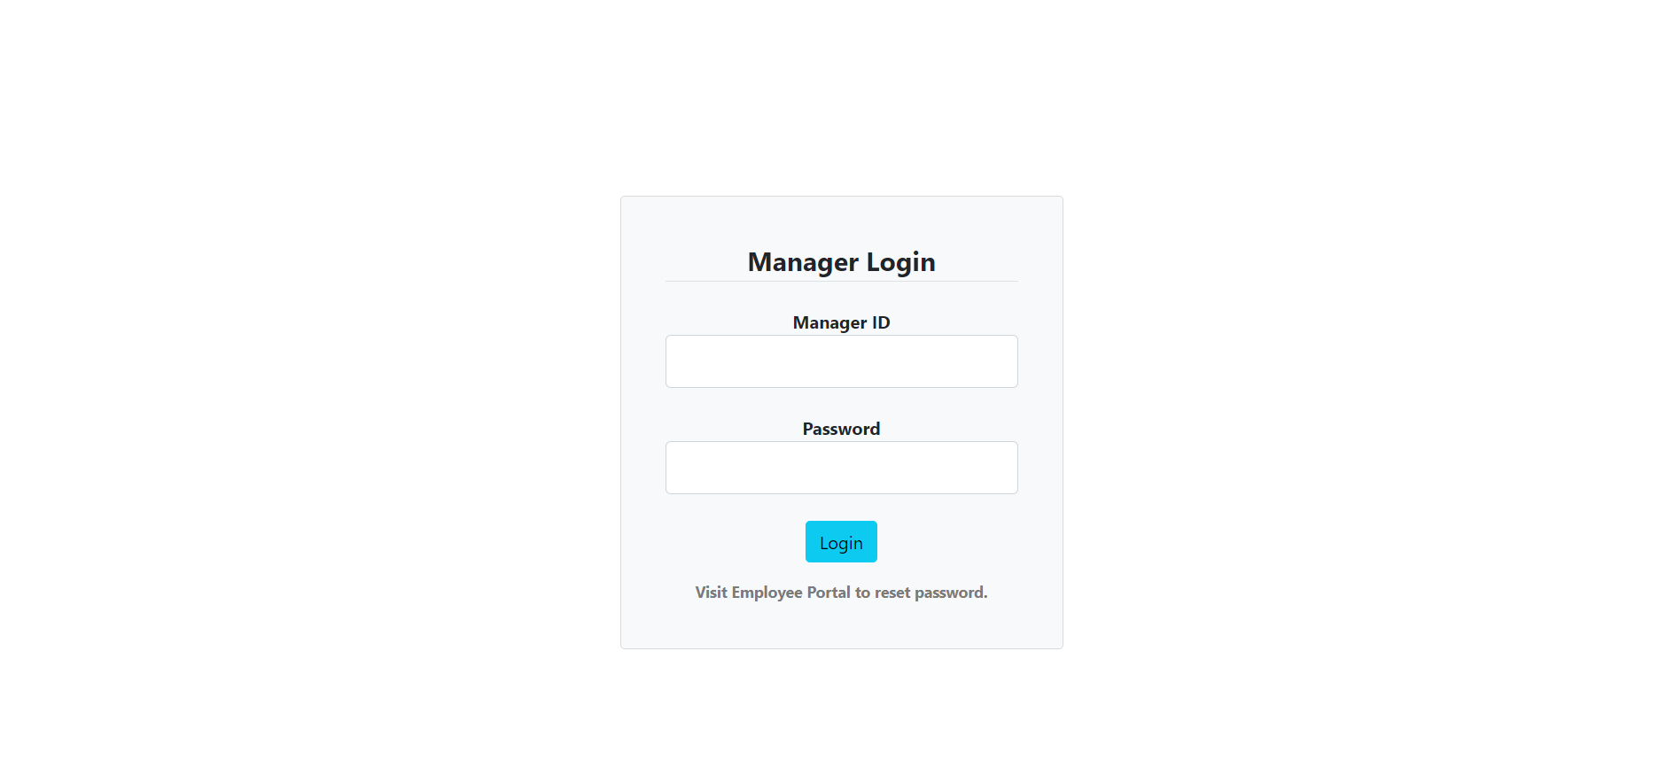
Manager’s Portal

Slide 17
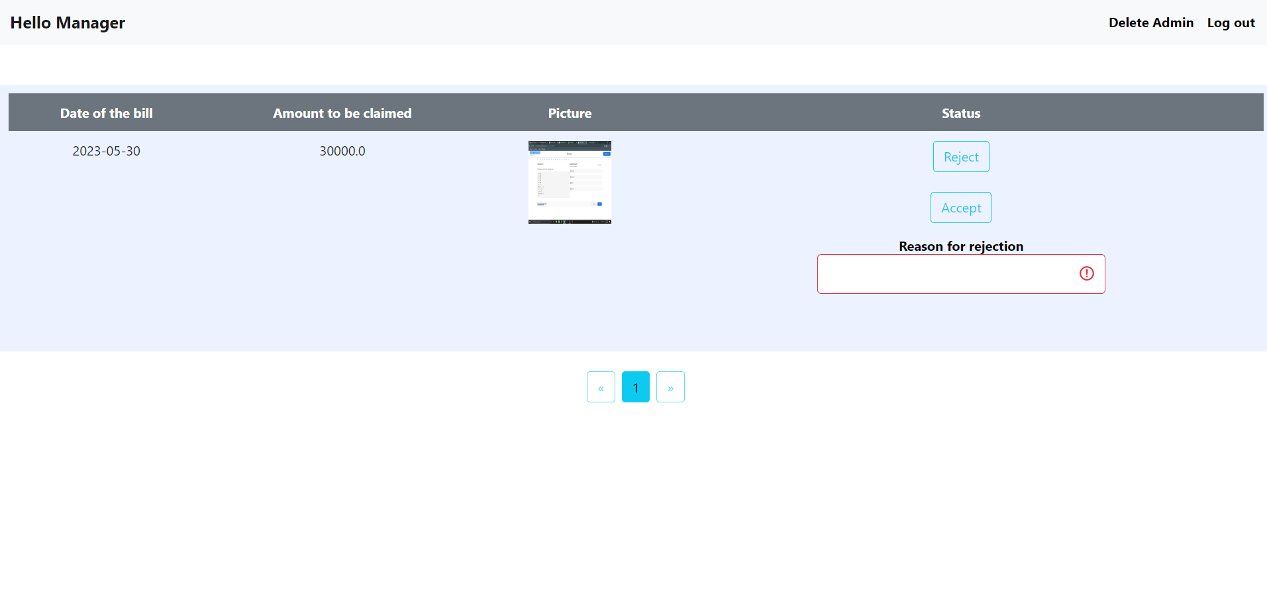
Manager’s Portal

Slide 18
Thank You

